Slide 1
Map Request Toolbar Workflow

Slide 2
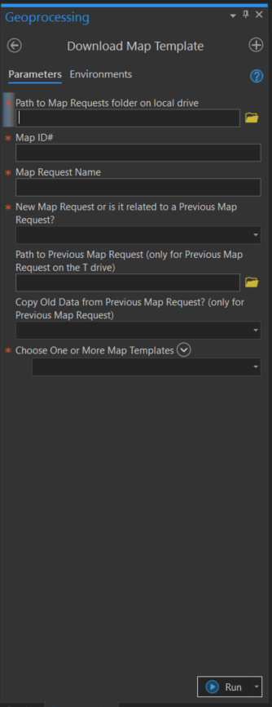
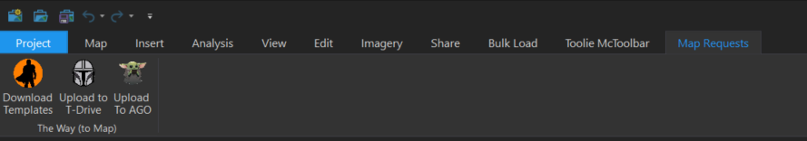
Download Templates
1. Path to Map Requests folder on local drive (Required*)
Select the location that you want to save the .aprx file with the downloaded map templates (e.g. C:\TxDOT\2020 Projects)
2. Map ID# (Required*)
Enter the numeral number of the map request (e.g. 1023)
3. Map Request Name (Required*)
Enter the name of the map request (e.g. Zilker Park)
4. New Map Request or is it related to a Previous Map Request? (Required*)
Select “New Map Request” in most of the time. Only select “Previous Map Request” when you need something related to the previous Map Request on T Drive
If you selected “Previous Map Request”, the following two options are REQUIRED to answer
5. Path to Previous Map Request (Optional)
This option only available if you selected “Previous Map Request” in advance
Select the path of the previous Map Request on T drive
6. Copy Old Data from Previous Map Request? (Optional)
This option only available if you selected “Previous Map Request” in advance
Yes: Copy all data from the previous map request folder to the Misc_Data_No_Upload folder after you run the tool
No: Create a text file (Path to Previous Map Request.txt) and listed the path of the previous map request folder in the Misc_Data_No_Upload folder after you run the tool
7. Choose One or More Map Templates (Required*)

Slide 3
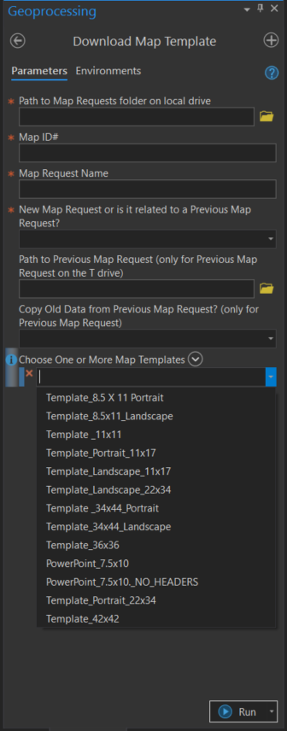
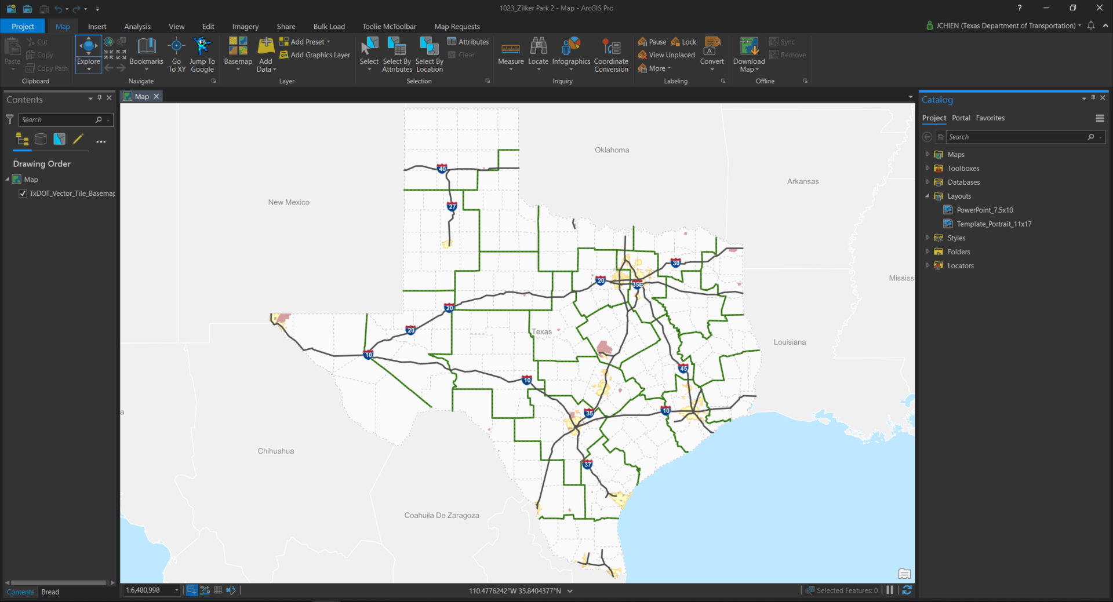
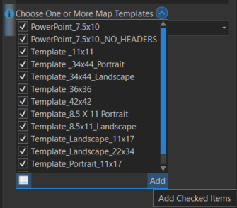
7. Choose One or More Map Templates
Select the map templates (.pagx) you need. The .pagx files will be imported to the created .aprx file after you run the tool and listed in Catalog Pane -> Layouts.
You can select all templates by clicking the "Add Many" icon -> Toggle All Checkboxes -> Add.

Slide 4
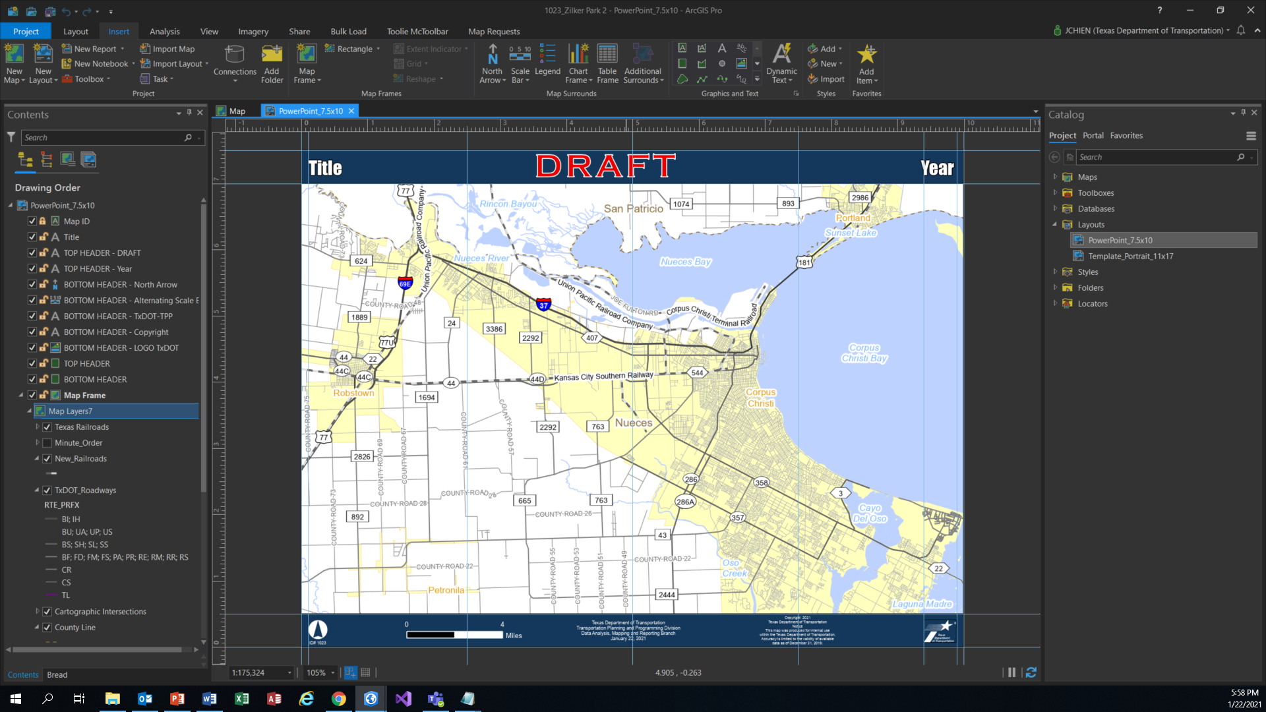
Map ID#

Slide 5
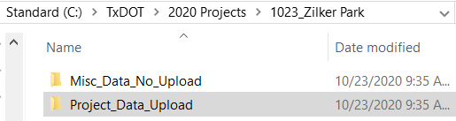
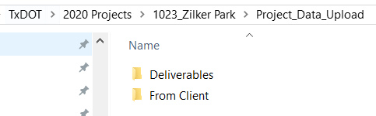
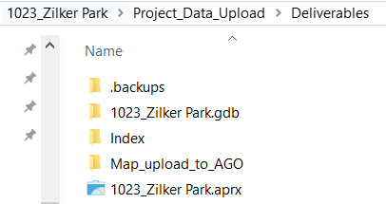
Find the APRX with the Downloaded Templates you just created
Path to Map Requests folder on local drive
\Map ID#
_Map Request Name
For example:
Your identified path of the Map Request folder is C:\TxDOT\2020 Projects\1023_Zilker Park
You’ll find your selected templates in the aprx file in C:\TxDOT\2020 Projects\1023_Zilker Park\Project_Data_Upload\Deliverables\1023_Zilker Park.aprx
Misc_Data_No_Upload folder
store the data that will not be uploaded to T drive (e.g. previous map request folder)
Project_Data_Upload folder
store the data that will be uploaded to T drive
Deliverables
Store the geodatabase, the aprx, and the Map_upload_to_AGO folder
Map ID#_Map Request Name.gdb (Geodatabase)
Map_upload_to_AGO (Folder)
You can export the final Map for client to here. It will be uploaded to AGO later.
Map ID#_Map Request Name.aprx (*The file you need!!)
From Client
Store the information (png, instruction, etc) from client to this folder

